Slide 1


Social Media Performance
(Data Cleaning and Viz)
Ashraf Mogal
May 25th, 2023

Slide 2

Context

Slide 3
The project goal is to…
“Define out a posting strategy for the social channels based on the discoveries”

Slide 4

Data

Slide 5
Summary of the Data Variables
Date and Time
Information
Social Information
Media Variables
Media Type
Published Date
Day of the week
Time of the Day
Account
Account Type
Campaign Name
Total Engagements
Total Impressions

Slide 6

Exploratory Data Analysis

Slide 7
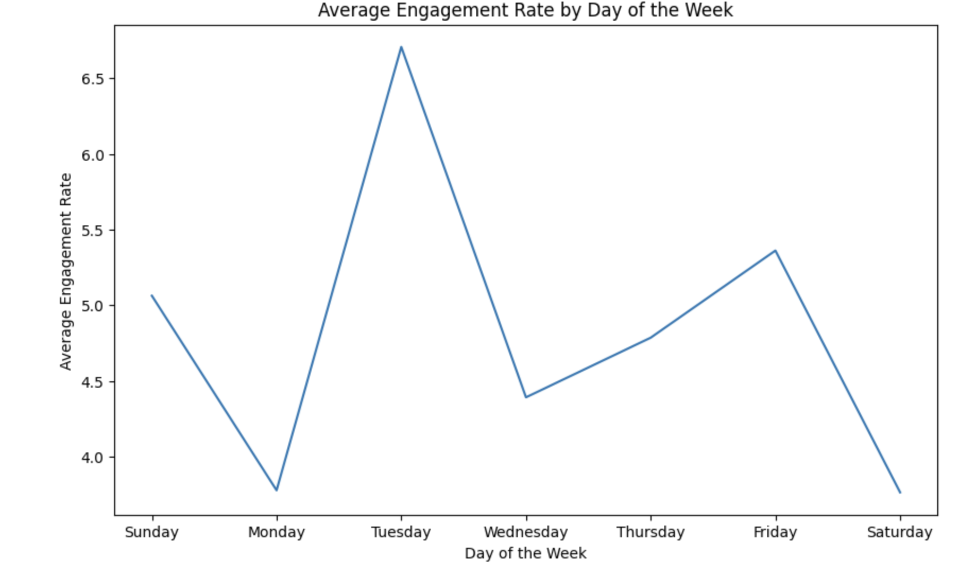
Average Engagements by Hour of the Day
Highlights
We can see that we are having the maximum engagement rate on Tuesdays and Fridays
We can observe that the least engagement rate is on Mondays and Saturdays

Slide 8
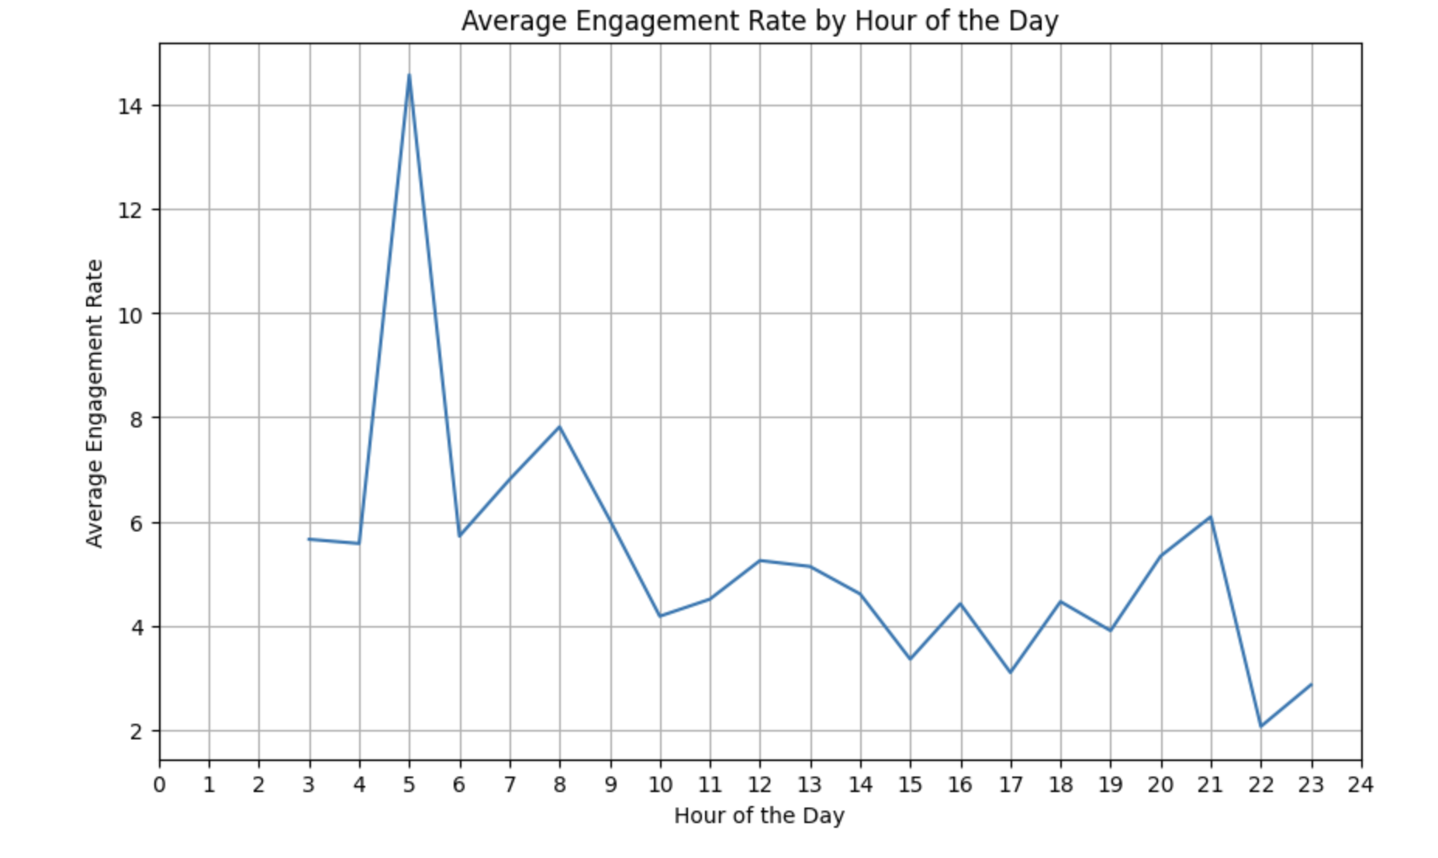
Average Engagement rate during hour of the day
Highlights
We can observe that the engagement is high between 5:00 am to 9: 00 am.
There is a spike between 7:00 pm to 9:00 pm
There are no engagements during the midnight and it is recommended not to send any campaigns during that time.

Slide 9
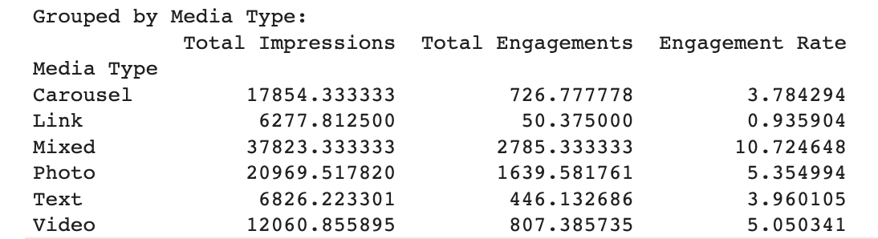
Best Media Type
Highlights
The best performing media type is Mixed which has nearly 11% engagement rate.
Links are having the least engagement rate as people tend to not click on the links as it might be spammy.
Video and Photos are having approximately 5% engagement rate which shows there is a lot of room to improve.

Slide 10

Strategy and Recommendations

Slide 11

Guidance for Stakeholders
Best Days: Tuesdays and Saturdays
Best Time: Post between 5:00 am to 8:00 am and also during 8:00 pm
Best Campaign Name: Give priority to Community Engagement
Best Media Type: Photo and Video
Best Game Title: Valorant and DOTA2
Best Account Type: Facebook, Tiktok business and Youtube

Slide 12
Thank you!

